Slide 1

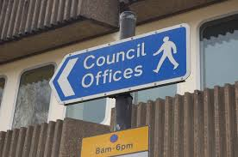
M06 – Local Democracy
& Active Citizenship (1)
L2 & 3 – Intro to Local Democracy
& Local Government
Tuesday, 22 March 2022
LO:
To understand how local councils are elected, organised and paid for
To understand how local councillors make decisions that affect us
Starter: Pair Activity
Discuss ideas about how
different adults’ decisions affect you
Complete your own worksheet “Who makes decisions that affect me?” on your desk
Homework:
Complete the internet research about Tower Hamlets Borough Council Services in our area
Notes:
Print off and hand out the next slide x1 per student – starter activity
H/W - Print off the worksheet from the file called “L2 - Tower Hamlets Borough Council Services- Internet HW” x1 per student

Slide 2
Who makes decisions that affect me?
Who makes decisions | What decisions do they make | How do those decisions affect me?
My Parents
My Teachers
The School Council
Tower Hamlets Borough Council
UK Government
Notes:
Starter Worksheet

Slide 3
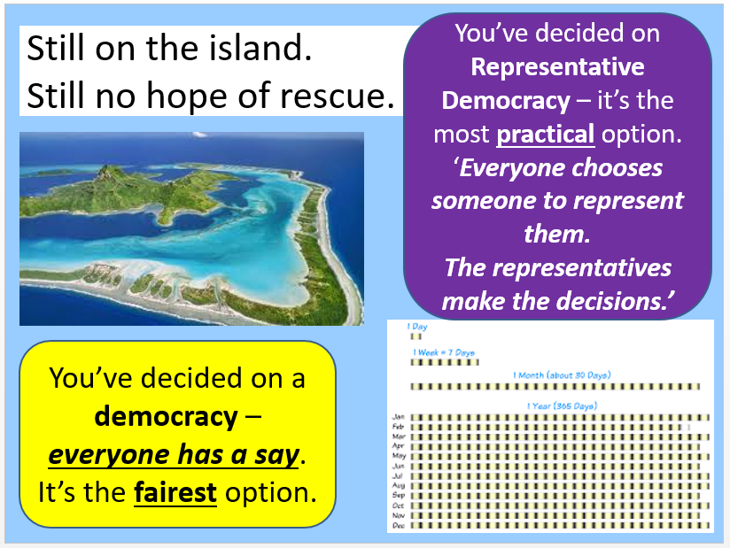
Representation and Representative Democracy
You learned about Representation in Yr7
  Remember when you created your Island Community…?
You made a
Representative Democracy!
  Politicians are elected by the people to represent them – to speak on behalf of the people
  Politicians are elected by the people to make decisions for the people
Module 2 – Create a Democracy
Lesson 2 – Who are the representatives?
Notes:
Read through this slide, and the next two slides, together as a class

Slide 4
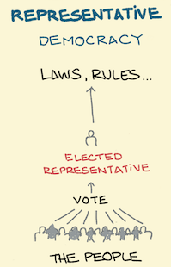
Representation– the Local Council represents citizens on local issues
School Councillors, the Tower Hamlets Council and the UK Government are made up of elected ‘politicians’ whose job it is to represent the views of the people.
School Councillors, the Tower Hamlets Council and the UK Government also make decisions on behalf of the people
For example
  School Councillors are elected to represent their fellow students at school.
  Together with the teachers, the School Councillors help make decisions about school rules, school uniform, school celebration days etc
  The Tower Hamlets Borough Council is elected to represent the people of Tower Hamlets.
  The Council make decisions on behalf of local people about local issues like housing, leisure, refuse, care homes etc

Slide 5
Local councils govern the local area
Local councils are responsible for governing local areas across the UK
They make decisions about how to collect local taxes and spend tax money on local public services
There are:
  410 local councils in England and Wales
  over 20,000 elected councillors representing local communities
  over 2 million people working for local government in England (including social workers, librarians, refuse collectors, park gardeners, lifeguards in leisure centres etc)
  over 39 million people registered to vote in local elections
This map shows all the local councils in England as at December 2020

Slide 6

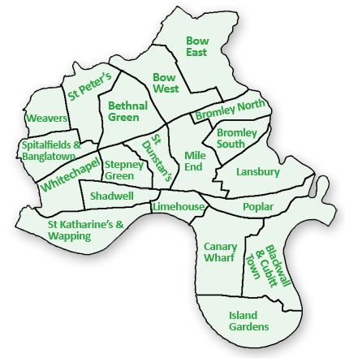
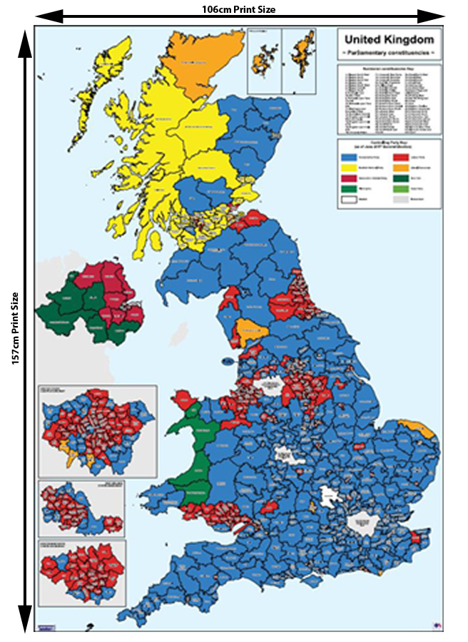

Local government vs National government – Which is more important to citizens? Why?
Class Discussion
Fewer people vote in local elections than in UK national elections
  This means that fewer people vote in the elections to choose the Local Council in Tower Hamlets, than vote in the General Election to choose our local MP, and decide who the UK Government will be.
About 30% of eligible voters vote in LOCAL elections
About 65% of voters in NATIONAL election (General Election)
Why do you think this is?
Notes:
Answers on the next slide…

Slide 7
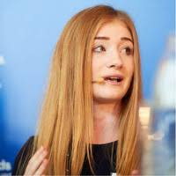
Local government vs National government – Which is more important to citizens? Why?
"Many people feel there isn’t a connection between local politics and their everyday lives. People have issues they care about, from local planning and leisure facilities to bin collections and schools, but it can be difficult to identify how local councils work and affect these issues.”
Rachael Farrington, founder of Voting Counts
- a campaign to encourage voters to register to vote.
“The Media pay little attention to the role councils and councillors play in communities. While UK politics dominate newspaper headlines and news stories it can appear that change can only happen via UK Government. Local councillors making decisions at a local level do not get the media attention they deserve.”
Notes:
Source:
https://www.bbc.co.uk/news/uk-england-47666080

Slide 8

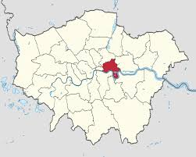
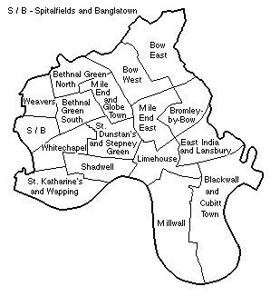
So, let’s research what our local council does, and how it works!
Notes:
Print off (3 slides to a page, double-sided) and hand out x1 per student slides 9, 11, 13, 14, 16, 17
Read through each INFORMATION slide as a class (9, 11, 13, 14, 16, 17)
Ask the students to complete the questions on the slide after (10,12,15,18).
Instruct students to write in PEEEL paragraphs, there are sentence starters on each slide, bottom left in the orange box
Source:
https://www.towerhamlets.gov.uk/lgnl/council_and_democracy/council_and_democracy.aspx

Slide 9
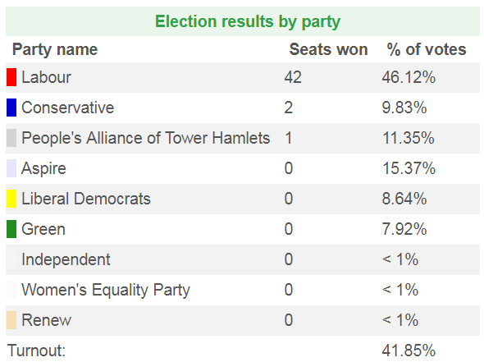
Who represents us? Who is in charge?
There are 45 councillors in total in Tower Hamlets, plus an elected Mayor
Elections for the council are held every four years.
  The last election took place in 2018.
The Labour party won the election – they won the majority of councillors (over ½)
  The elected Mayor leads the Council, and the current Mayor is a Labour representative too!
Therefore, the Labour Party control the decisions made in
Tower Hamlets Borough Council
You can see from the table that other parties put forward candidates in the election. But not all of them actually managed to get one of their candidates elected – their candidates did win enough votes to win the job!

Slide 10
Who represents us? Who is in charge?
Individual Activity
Answer these questions in your books
  Use facts from the previous slide in your answers
  Use the question to start your answers
    See the box below for the sentence starter for Q1
How is the Tower Hamlets Borough Council chosen?
Who controls the Tower Hamlets Borough Council at the moment? Why this this?
Q1. Tower Hamlets Borough Council is chosen every …………..……………………. in an ………………….. In the most recent election in 2018, the people of Tower Hamlets elected ……………………………..… The ………... Party runs the Council because ……..

Slide 11
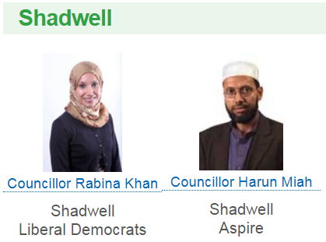
Who represents us?
How do the represent us?
The borough of Tower Hamlets is divided into 20 smaller areas called ‘wards’
  The people of each ward vote for their local councilors in the Tower Hamlets Borough Council elections once every 4 years
Each ward has between 1 - 3 councillors
  Limehouse and Poplar have 1 councillor each
  Shadwell has 2 councilors
  Whitechapel has 3 councilors
Councillors who represent each ward work together to investigate issues that affect local people
  Councillors invite the local people to come to meetings and have a say in what happens in their area
  Councillors then share what the local people in their ward want in Council meetings
Once Councillors have been elected, each councillor represents the ALL people in their “ward”
  It doesn’t matter if a local person supports Labour, Conservatives or Lib Dems, the local councillor has to listen to and respond to their views and needs.
  Whatever a local councillor’s own political views, they must try to help anyone in their ward with problems with the Tower Hamlets Borough Council
For example, Rabina Khan is a Liberal Democrat Councillor and Harun Miah is an Aspire Councillor
But, they both have to listen to, and help, local people who support the other political parties as well, not just their political parties!
Notes:
Additional Teacher Info:
Cllr Rabina Khan joined the Liberal Democrat party in 2018, after dissolving the People's Alliance of Tower Hamlets party, and after she had already been elected as a councillor. This is why there were no Lib Dem Councillors listed on the 2018 election results!
http://www.towerhamletslibdems.org.uk/councillor_rabina_khan
Cllr Harun Miah won his seat on the THBC through a by-election in 2019, winning a seat for the Shadwell ward. This is why there were no Aspire Councillors listed on the 2018 election results!
https://en.wikipedia.org/wiki/Aspire_(political_party)
Sources:
https://www.towerhamlets.gov.uk/lgnl/community_and_living/borough_statistics/Area_profiles.aspx
https://democracy.towerhamlets.gov.uk/mgMemberIndex.aspx?FN=WARD&VW=LIST&PIC=0

Slide 12
Who represents us?
How do the represent us?
Individual Activity
Answer these questions in your books
  Use facts from the previous slide in your answers
  Use the question to start your answers
    See the box below for the sentence starter for Q3
Who / what do local councillors represent?
How do local councillors find out what local people think?
How do local councillors ensure that local people’s views are represented at the Council?
Q3. Local councillors represent … …………………… For instance, ……… …..………………………….....................

Slide 13
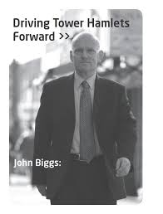
How do councillors help local people?
Meet the Executive Mayor of Tower Hamlets Council
– John Biggs!
As well as representing local people’s views at Council meetings, councillors help local people in other ways too
Local councillors hold regular ‘surgeries’ where can go to help help and advice
Surgeries are drop-in meetings where local people can go to discuss problems with their local councilor
  For example, you might need help with a housing issue:
    Your landlord who has put up the rent by a massive amount and not warned you.
    You cannot afford to pay the new rent.
    But you cannot afford to move either.
    You need some help and advice.
    You local councillor can help!
Just like Rabina and Harun, he holds surgeries for the public, where people can go for help and support.
Mayoral surgeries are held every week, on a Thursday from 5:00-7:00pm at the Whitechapel Idea Store or the Town Hall, Mulberry Place, Clove Crescent.
You must pre-book an appointment in advance
Notes:
http://democracy.towerhamlets.gov.uk/mgUserInfo.aspx?UID=1794

Slide 14
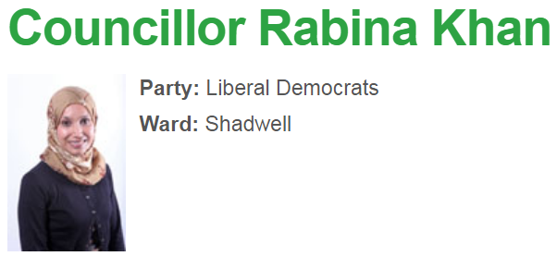
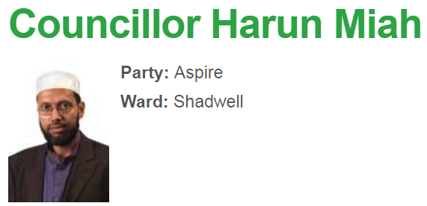
Is being a Councillor a full-time job?
You can find out more about each councillor, and what they do for us, on the Tower Hamlets Borough website
Local Councillors are all volunteers. They work as Councillors in their spare time. They also have day jobs which they do to earn money to pay their bills! (For example, Rabina is a writer, publisher and TV producer. She runs her own company)
Notes:
Click on each person’s image to open the hyperlink to their councillor webpage – demonstrate just one person to the class

Slide 15
How do councillors help local people?
Is being a Councillor a full-time job?
Individual Activity
Answer these questions in your books
  Use facts from the previous slide in your answers
  Use the question to start your answers
    See the box below for the sentence starter for Q6
Local Councillors are very busy people, why is that?
How do local councillors help local people, other than representing their views and needs at Council meetings?
Q6. Local councillors are very busy people because ……… For example,… ………………………………………………………

Slide 16
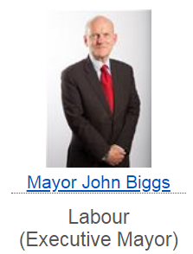
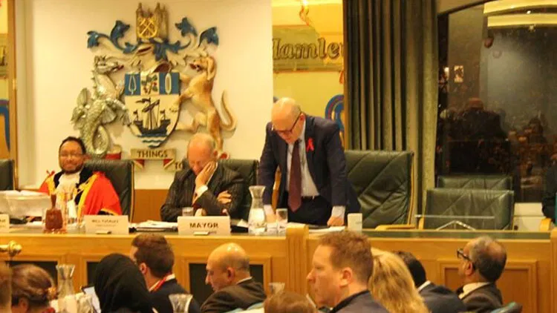
How does the Council make decisions?
All 45 councilors, plus the Mayor, meet as a group a few times a year to discuss and agree on the BIG decisions for Tower Hamlets.
  For example, the annual budget – what the council is going to charge in local taxes and spend on local public services
These BIG meetings are called Assembly Meetings. In the Assembly meetings, the councilors discuss issues which affect all of Tower Hamlets
  The councilors debate and vote on the BIG decisions for the borough as a whole. Together, they try to do what is best for everyone in Tower Hamlets
  Each councillor will try to convince the other councillors to agree to
  changes based on their political party’s big ideas. For example, our 2 local councillors in Shadwell belong to different political parties and have different ideas:
    Rabina Khan supports Liberal Democrat ideas
    Harun Miah supports Aspire ideas
Most of the smaller
decisions are made in smaller groups of councilors. These specific groups of councilors are called, Committees
  The Cabinet is a committee made up of the Mayor and 9 Councilors chosen by the Mayor.
    Together they decide on how much money to spend on specific public services, e.g. rubbish collection, schools
  Other small groups of councilors make decisions on other local issues, for example the Health and Well Being Board
    Our local councillor Harun Maih is on the Members’ Learning and Development committee which discusses and agrees ideas to help councillors to be better councillors!

Slide 17

Where does the Council get it’s money from?
What does the Council spend it’s money on?
1 - The UK Government
Local Councils are given some money by the UK Government - but it is never really enough!
2 - Council Tax
People over 18 who live in a local council area, pay a tax each year based on the value of their home:
  The higher the value of the home, the more people pay in Council tax
  The lower the value of the home, the less people pay in Council Tax
3 - Business Rates
People who run a business in the area pay a local tax to the council for the buildings that they use to run their business
Local councils get 70% of their money from the UK Government, 20% from Council Tax and
10% from Business rates.
In total, in 2019-2020 Tower Hamlets Borough Council received £374m in taxes. It spent this on providing local services for people in Tower Hamlets, i.e. social services, Idea stores, parks, council houses…
Notes:
Source:
https://www.towerhamlets.gov.uk/Documents/Finance/Local-taxation/Council-tax/Council_Tax_Booklet_v5.pdf

Slide 18
How does the Council make decisions?
Where does the Council get it’s money from?
What does the Council spend it’s money on?
Individual Activity
Answer these questions in your books
  Use facts from the previous slide in your answers
  Use the question to start your answers
    See the box below for the sentence starter for Q8
How does the whole Council make BIG decisions together?
Local people get more LOCAL public services than they pay for, why is this?
Q8. The whole council make BIG decisions together …………….. For instance, …………… ………………………………………..…………………….

Slide 19
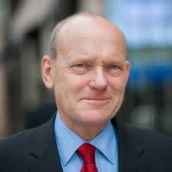
Leader for a Day
Be me for a day!
What are the most important public services to you as young people?
I wonder if they are different from my priorities as an elected councillor, and adult…?
John Biggs, Executive Mayor of Tower Hamlets Borough Council, has asked you to run the borough for one day
  He wants to understand what young people’s priorities are for the borough
  You have to decide how to spend Tower Hamlets’ money on running public services
  You have to be able to justify your decisions to the public
Rules for Spending!
You have an annual budget of £10 million
  You MUST NOT spend more than £10 million
  You MAY spend less than 10 million and give council tax payers a refund
You MUST spend money in each of the 4 areas of public services
  Transport
  Environmental Health
  Education
  Social Services
John Biggs – Executive Mayor of
Tower Hamlets Borough Council
Notes:
Print off and hand out x1 per student pp2 of the doc “learning through local elections – student worksheet 7” from the folder
Read through this slide and the next together as a class.
Ensure that students understand that they work in a pair, but each student fills in their own worksheet

Slide 20
Leader for a Day
Pair Activity
Read the “Leader for a Day” worksheet
Think about the different options:
  Which are most important?
  Which would affect most people?
  Which would be most popular?
Decide on which option (from each box) you think is the best
Circle your chosen options on the worksheet and annotate each one with key words to explain your choice… “help elderly”, “get people to work” etc
Individual Activty
Write a PEEL paragraph for at least 2 of your choices stating your choices and justifying why you chose them
  Use the writing frame below to help you…
“If I were Council leader, I would spend £__ million on ……….…… because ………..………………… For example if I did / didn’t spend it on this, then ……………….…...
I would also spend £___ m on … ………… because ……….……… For instance ……………….……...
………………………………………

Slide 21
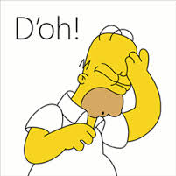
Homework
Don’t be like Homer! Do it properly!
Research about Tower Hamlets Borough Council Services in our area
  Use “E1 2JP” – that’s the postcode for the school!
Complete your worksheet in the booklet with the correct answers from the Tower Hamlets Borough Council website
For question 10 you will also have to complete research using other websites
“Went online. Found the answers. Got them all in my head ready for the teacher next lesson!
Hm? Worksheet?
Writing it down?
What are you on about?”

