Slide 1
UK Political Parties elected in UK Parliament
Notes:
Run through the slide explaining where the smaller political parties come from:
(FYI - Each logo is hyperlinked to the political parties’ homepage if the students are interested in any specifically you can open the hyperlink by clicking on the image.)
England & UK
Conservatives
Labour
Liberal Democrats
Green
Scotland
Scottish National Party – SNP
Wales
Plaid Cymru
Northern Ireland
Democratic Unionist Party
Sinn Fein
Social Democrat and Labour Party
Alliance

Slide 2
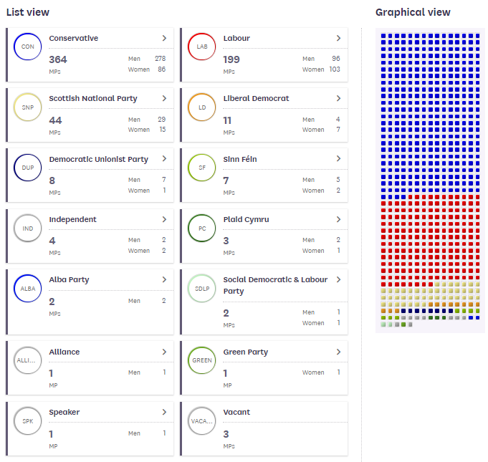
To win a General Election a political party must win the majority of seats (MP’s) in the House of Commons – that’s 50% +1 of 650 seats= 326 MP’s
As at 30 April 2021
Notes:
Run through the slide
“Current State of the Parties” image is hyperlinked to the original source of info, click to open the webpage on UK Parliament website.

Slide 3
What are Political Parties...?
A group of people who have similar political beliefs.
They work together to develop their ideas into policies (e.g. what they want to do about Education).
They develop political campaigns (e.g. posters, speeches, leaflets, meet and greet) to promote their policies to the public to convince people to vote for them an election.
Their aim is to win enough MP’s across the UK to win the General Election and become the UK Government
Notes:
Ask the students to copy down the definition of Political Party into their books
Click to reveal Political Parties’ aims...
Ask students to copy that down also.

Slide 4
What are Manifestos…?
Before a General Election, each Political Party writes a Manifesto...
A Manifesto is a detailed book of promises about what the party will do if they win the General Election and become the next government
Labour 2017
Conservatives 2017
Liberal Democrats
2017
Notes:
Run through the information on the slide
FYI - Each image is hyperlinked to the actual party manifesto from the 2017 General Election, if students are interested to see what one looks like click on the image and flick through a manifesto

Slide 5
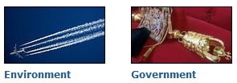
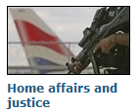
Manifesto Pledges
Manifesto pledges cover all the main areas of government:
Notes:
Run through the information on the slide

Slide 6
Manifesto Pledges on Education 2017
Pair Activity
Read the Manifesto Pledges from the Conservatives, Labour and Liberal Democrats from the 2017 General Election
Answer the questions on the right in your books
For Question 2 you need to decide which party you think offered the best deal and then explain why, giving examples
Which parties promised to do the following:
Allow more selective schools
Introduce a Pupil Premium for the poorest students
Allow teachers to earn more, (stop the pay cap / limit)
Which party offered the ‘best deal’ for young people in education? Choose ONE of the types of education below. Why is it the best deal?
Secondary School
Further / Higher Education (6th Form College & University)
Notes:
Print out onto A3, the “2017 Political Party Manifestos - Education Pledges - student info sheet” from the folder x1 per pair

Slide 7
Other campaigning methods
Political parties also develop a range of campaign activities in the run up to an election to convince voters to vote for them...
Individual Activity
On the desks around the room are different types of methods…
Find AT LEAST 5 methods and complete the worksheet with the information you find
Rate each of the 5 methods with how effective you think it is at convincing people to vote for a particular political party’s candidate
1 very unsuccessful
2 unsuccessful
3 not sure either way
4 successful
5 very successful
You are about to judge a range of REAL LIFE campaign materials from recent US and UK election campaigns...
Notes:
Print off and hand out the next slide x1 per student as a Fact Finding worksheet
Print off and stick up around the room slides 10 – 25 (only one sheet of each)
Ask the students to walk around the room and collect information about at least 5 different types of campaigning methods
Run a mini-plenary at the end to find out what the top 5 BEST campaigning methods are, and why? Plenary Slide

Slide 8
 | How it is designed to work? | How effective is it at promoting a political party? 5 = Very Good, 1 = Very bad
 |  | 1 | 2 | 3 | 4 | 5
Rosettes & Badges | Publicise the political party; get people to remember the party and the name of their candidate |  |  | X
Leaflets
Signs
Flags
Mascots
Positive Adverts FOR your own party
Negative Adverts AGAINST the other parties
Wackier Ideas
Canvassing for Votes
TV Debates
Speeches
Rally / Street Marches
Polling Station conversations

Slide 9
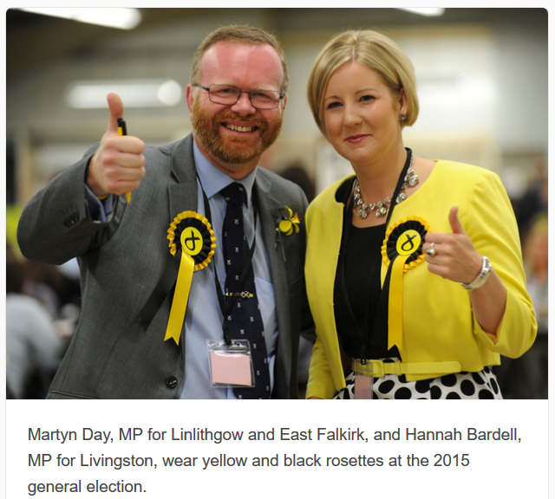
Rosettes (with ribbon around the edges) and Badges
Two MPs in Scotland wearing the rosette of their party (SNP) during the 2015 General Election
Parties also make badges like the one on the right for one of Barack Obama’s Election Campaigns (see below)
Badges and rosettes usually promote have the name of the candidate and the main manifesto pledge of the political party

Slide 10
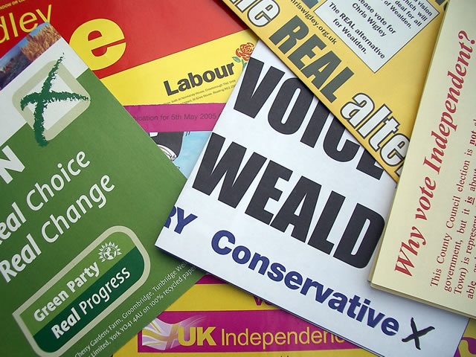
Leaflets that will come through your door which summarise the main manifesto pledges the party are promising if they get elected.

Slide 11
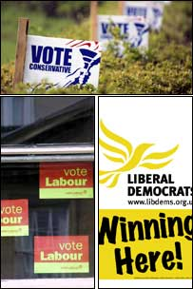
Different types of signs in the constituency...
On big billboards on the side of the road...
In gardens...
On the sides of houses...
In house windows...
In car windows...
They are all designed to remind people to vote, and to vote for a specific party and candidate

Slide 12
Positive Adverts - they are designed to show off how good a party is (what their achievements are, the best things they are promising in their manifesto)
This is a positive Labour advert made by Labour Party. It is pointing out what the Labour Party has done well.

Slide 13
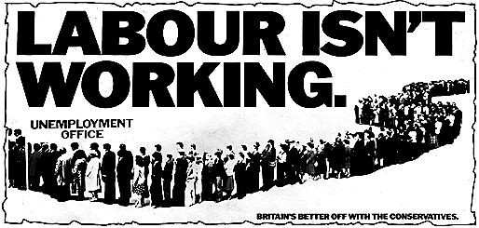
Negative Adverts – they are designed to point out how bad the other parties are, (what their worst failures are, the worst things they are promising in their manifesto)
This is a negative advert made by the Conservative Party. It is pointing out how bad the Labour party was – its from the 1970’s

Slide 14
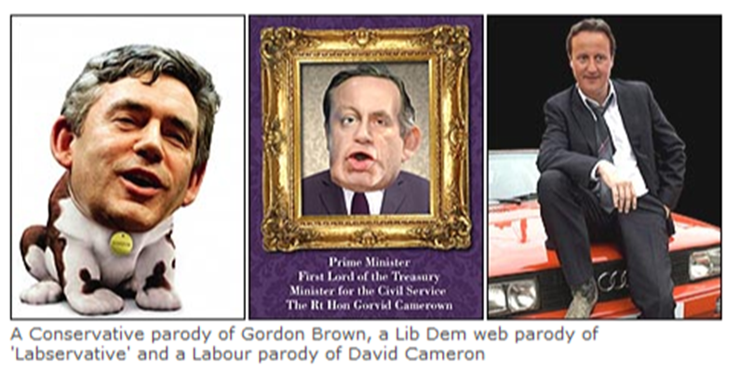
Negative Adverts - “Parody Advertising”
These adverts are made by different political parties to poke fun at the leaders of the other parties. The adverts try and make the leaders of the other parties into a “joke” – can you see the leader of the Labour Party in 2010 (Gordon Brown) made into the dog from the Churchill Insurance advert. The Conservative party made this advert!

Slide 15
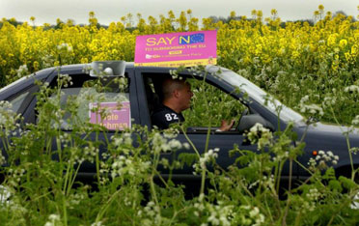
During elections there are lots of campaign materials all over the local community. It is hard to get noticed so some Political Parties also try wackier ideas. This is UKIP during the European elections in 2009. Someone is driving around the local community with a loudspeaker telling people to vote for UKIP and telling everyone what they are promising.

Slide 16
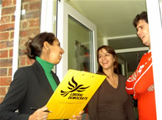
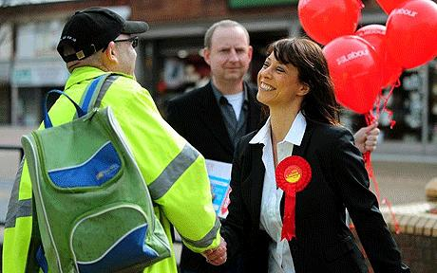
Canvassing for votes
Candidates, and their supporters, go door to door and along the High Street talking to about their policies and people asking for their vote. This is called Canvassing. It is a good way to answer the voters questions in person and become better known in the community.

Slide 17
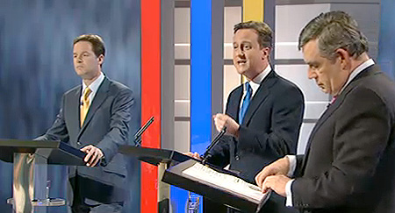
TV Debates – this is a photo of the first ever series of Leadership TV Debates in the UK in May 2010. It is an opportunity for the leaders of the main political parties to get their points across on live TV and ask the leaders of the other parties difficult questions to try and catch them out!

Slide 18
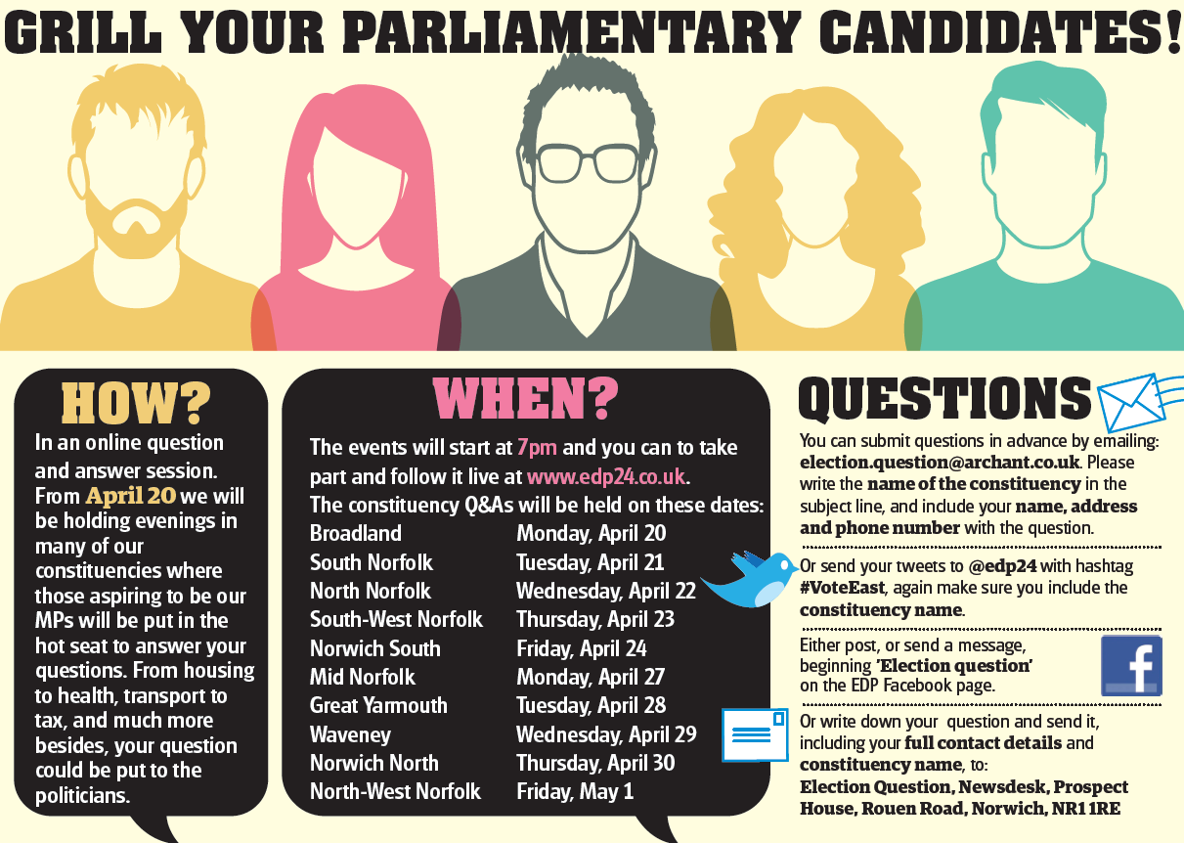
This is an advert in a local newspaper in East Anglia, England inviting citizens to go to a hustings meeting during the 2015 General Election campaign.
A Hustings Meeting is a chance for candidates up for election to make a speech about what they stand for, and for the local people to ask them questions.

Slide 19
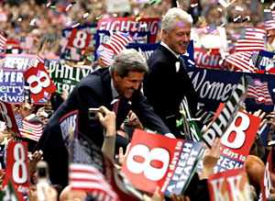
This is a rally in the 2004 USA presidential elections
Rallies are not a very common campaign method in the UK for general elections. They are sometimes used for specific campaigns to do with a specific issue, like Brexit.
A rally is a big meeting where the leaders of the party or the local candidates make speeches.
It is supposed to be a celebration event to make the supporters of the party and candidates feel good about voting for them – like a thank you.
Usually there are speeches, music, food etc

Slide 20
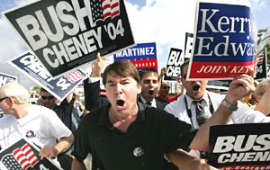
Campaigners go on a street march in the 2004 USA Presidential Elections. It is very similar to a rally.
Similar to rallies, street marches are not a very common campaign method in the UK for general elections.
They are often used for specific campaigns to do with a specific issue, such as increasing funding to the NHS or schools.

Slide 21
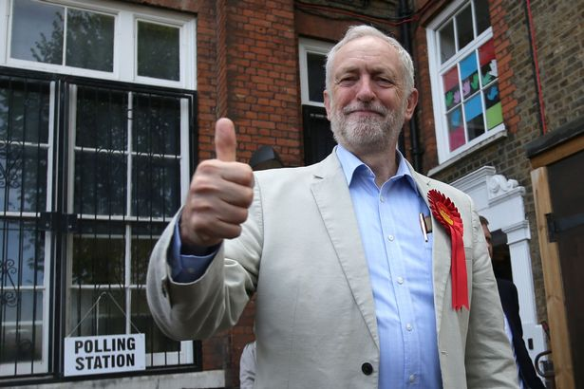
Late on Election Day, political parties and their candidate and campaigners might talk to the voters as they enter the Polling Station (where you go to vote). This is a last minute effort to convince people to vote for them. This is Jeremy Corbin, the ex-leader of the Labour Party outside a Polling Station in 2018 (Local Council Elections)

Slide 22
Plenary
Class Discussion
Which campaign method do you think was the most successful?
Why?
How successful do you think that Party Manifestos are in convincing people to vote for their party?
Why is that?
Why are they so important then?
Notes:
Tease out the following:
Campaign materials have 2 functions:
inform loyal voters which candidate to vote for on Polling Day – i.e. I’ve always voted Conservative, I will always vote conservative I just need to know who my candidate is this time...
convince first time voters / swing voters which political party and their local candidate will do the best job for them – i.e. get their party & candidate known, promote their best policies to get people’s attention and convince them to vote for them
Manifestos are important because...
Even though the average voter never reads the manifesto, the media do and quote from it frequently so the political parties need to get their ideas straight and simple to communicate
Also, after the election people can go back and check whether the political party is delivering what they promised they would do. If not the people can campaign or protest for change – even voting them out at the next election...! (Mention the Lib Dems promise to abolish University Fees in their manifesto and they agreed to increase them as part of the Coalition Government!!!! What will happen to them at the next election???)

