Slide 1
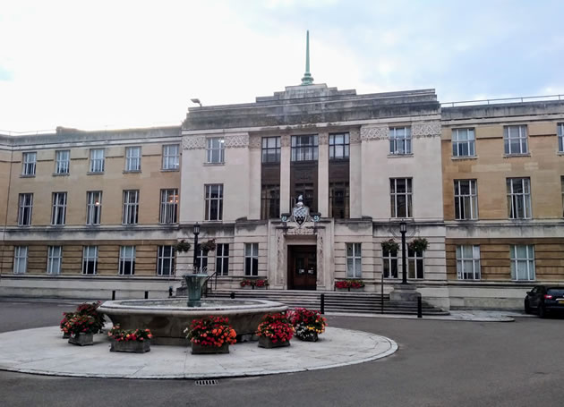
Your Vote Counts
local government and you

Slide 2
Parliament and Local Government
Central Government (Parliament):
determines the responsibilities to be carried out by local government
is the primary source of funding
determines the rules for local government income (e.g., sets business rates, limits council tax increases)
MPs can influence legislation that governs services to be provided by local government. They cannot make decisions about how or to whom local services are provided.

Slide 3
Responsibilities of London Boroughs
Education
Highways
Transport planning
Social care
Housing
Libraries
Leisure and recreation
Environmental health
Waste collection
Waste disposal
Planning applications, licensing
Strategic planning
Local taxation collection
Councillors make decisions about local services. They do not have the power to offer services not authorised by central government.

Slide 4
How Wandsworth Council Works
Councillors representing geographic wards are elected every four years
The party with the most councillors runs the borough Council and elects the Council leader
Decisions by the Council are carried out by the chief executive and civil servants
Current composition of the Council:
Conservative 33 (-7 from previous election)
Labour 26 (+7 from previous election)
Independent (+1 from previous election)

Slide 5
Declining Income
Council tax is less than 1/3 of local government income
According to the National Audit Office, since 2010-11, Wandsworth’s spending power has decreased by 32%; the population has increased by 9%
Since 2013-14, local governments have been able to keep 50% of the business rates they collect, but this has not offset the decline in funding from central Government
Source: National Audit Office; ‘000’s

Slide 6
Adult social care dominates spending
According to the National Audit Office, service spending in Wandsworth has declined 19.5% since 2010-11
Adult social care is the single largest category of spending, but has declined since 2010-11
Schools are funded separately and have not been included in the income or spending data
Source: National Audit Office; net of sales, fees and charges; ‘000’s

Slide 7
